Slide 1

MAHARSHI KARVE STREE SHIKSHAN SAMSTHA’S
Academy Of Information Technology
Center for Data Science, Machine Learning and AI

Slide 2
Academic Analytics: A Strategic Overview of Institutional Performance
Project by _MKSSS’s AIT

Slide 3
Agenda
Introduction to the university's ledger system
Challenges with unstructured, missing, and hard-to-interpret data
Project Objectives
Methodology
Results and Achievements
Demonstration
Impact on Colleges, Faculties, and Students
Future Opportunities

Slide 4
Introduction to the University's Ledger System
Format and Distribution:
Ledgers are provided in PDF format.
For each semester, universities share ledgers with respective colleges.
Unstructured Data:
The data within these ledgers is unstructured.
Lack of a consistent format across ledgers.
Data Accessibility Challenges:
Difficulty in accessing specific student records due to varied ledger formats.
Stress the need to manually search through different ledgers to find particular student data.

Slide 5
Introduction to the University's Ledger System
Issues Faced:
Missing Data: Face challenges because of missing information within the ledgers.
Lack of Centralization: Data is scattered across multiple ledgers, making retrieval cumbersome.
Impact on Efficiency:
These challenges impact the efficiency of data extraction and management processes.
Click here for sample data ledgers

Slide 6
Project Objectives
Efficient Data Extraction
Automated solution for extracting student details
Significantly reduced manual data entry efforts
Structured Data Organization
Focus on organizing extracted data into Excel spreadsheets
Ensured accessible, consistent, and analysis-ready information
Data Visualization Dashboard
Design a user-friendly dashboard for dynamic insights
Empowers data-driven decisions and effective academic monitoring

Slide 7
Benefits and Outcomes
Enhanced Data Reliability
Automated extraction will improve data accuracy.
Time and Cost Savings
Significant reduction in time and resources required for data entry.
Streamlined Reporting
Efficient reports generation and finding out insights with structured data.
Interactive Data Dashboard
Emphasize the user-friendly dashboard's role in effective academic monitoring.

Slide 8
Impact on Colleges, Faculties, and Students
Colleges and Faculties:
Efficient Oversight:
Streamlined data for easy monitoring.
Timely insights for informed decision-making.
Resource Optimization:
Saves time and costs for reallocation.
Redirects resources to educational initiatives.
Students:
Transparent Progress:
Interactive dashboard for clear records.
Identifies areas for improvement.

Slide 9
Impact on Colleges, Faculties, and Students
Timely Intervention:
Real-time insights enable quick action.
Facilitates collaboration for student success.
Overall:
Enhanced Decision-Making:
Informed decisions for better outcomes.
Improved collaboration for a supportive environment.

Slide 10
Methodology
Utilization of Python, PDF libraries, and regular expressions:
The combination of Python, PDF libraries, and regular expressions automated the extraction of individual student details from different ledger files at storing it together at one place.
Power BI for Dashboard Creation:
Dynamic Visualization
User-Friendly Interface
Real-time Insights
Centralized Records

Slide 11
Future Opportunities
Commitment to Ongoing Innovation and Efficiency:
Our dedication to innovation remains unwavering. Moving forward, we will continue to explore cutting-edge technologies and methodologies to enhance data extraction and management processes.
Continuous improvement is at the core of our approach, ensuring that our solutions evolve with the dynamic needs of the university environment.
Potential for Further Collaboration:
We recognize the importance of collaboration in achieving collective goals. Going forward, we are open to further collaboration with university departments, faculty members, and other stakeholders.
By working together, we aim to identify new challenges and opportunities, fostering an environment that encourages knowledge-sharing and collective problem-solving.

Slide 12
Future Opportunities
Impactful Solutions on the Horizon:
Our journey doesn't end here. We envision developing and implementing impactful solutions that extend beyond data extraction, addressing broader challenges faced by the university.
From academic analytics to administrative optimizations, we aim to contribute to the university's success by providing solutions that make a meaningful difference.

Slide 13
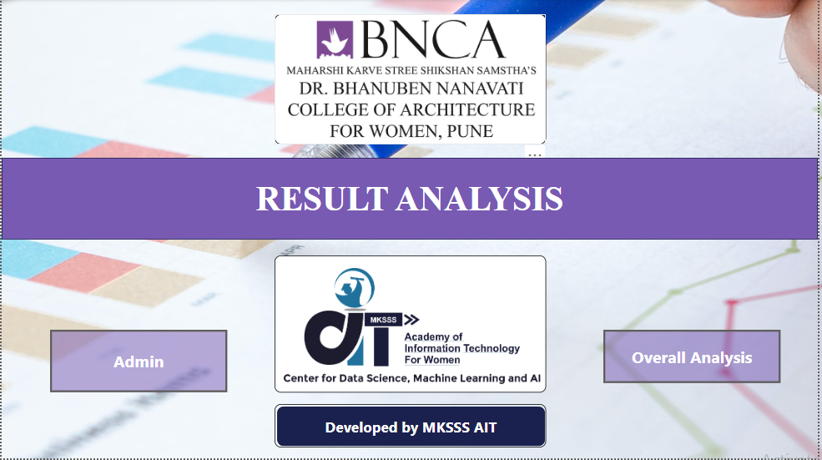
Dashboard Demonstration
Click here for more Dashboard Images
Click here for PowerBI Dashboard

Slide 14
Feedback
Your input is invaluable. We invite feedback from university personnel to shape the direction of our future projects.
Your insights will play a crucial role in tailoring our solutions to meet the unique needs of the university.

Slide 15
Thank You!

